Slide 1
Critique Mining (Ecommerce product reviews)
Balamanikandan Gopalakrishnan
Malika Thapa
Rachan Hegde

Slide 2
Goals
Business
Users should be able to identify products with better customer satisfaction
Users should also be able to identify the manufacturers and brands with better customer satisfaction to mange their inventory
Provide Business Insight and Analytics to the business owner using data visualization techniques
Technical
Load the data set into a NoSQL (Mongo DB) data base after performing data analysis and deduplication
Parse product reviews (JSON format) using Scala
Identify category of each word in the review using LIWC (Linguistic Enquiry and Word Count)
Analyze the word count in each of these categories to classify the review
Parallelize classification using Spark

Slide 3
Methodology
LIWC (Linguistic Inquiry and Word Count)
LIWC is a standard in computerized text analysis
Text analyzer reads a given text and counts the percentage of words that reflect different dimensions (emotions, thinking styles, social concerns, and even parts of speech)
http://liwc.wpengine.com/
MLib – Spark
Used to identify the classification of reviews

Slide 4
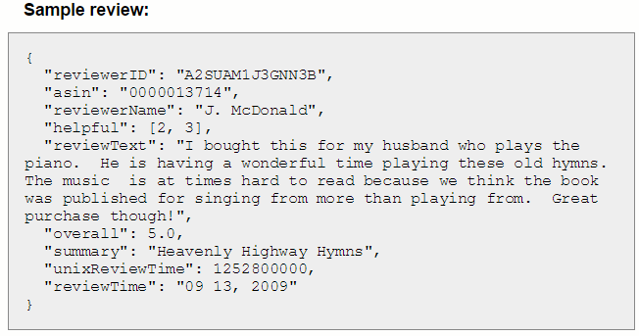
Data sources
LIWC dictionary (http://liwc.wpengine.com/compare-dictionaries/) Currently 85 different dimensions (emotions)
Amazon product data
The volume of the data set under consideration is ~20GB(~90 Million Records)
The data set consists of the following details
Metadata regarding the product
Reviewer Information
Product Review

Slide 5
Milestones
Date | Description
3/22/2016 | Analyze the data structure and devise strategies for data analysis.
3/29/2016 | Write components to parse JSON review data and product meta data, Load dictionary (LIWC) data for comparison from CSV, custom format in Scala and perform unit testing for each module.
4/5/2016 | Compare the review text with LIWC dictionary data and calculate the percentage of words in each dimension and perform unit testing. Scale the component modules to process Big Data using Apache Spark. Load the final out put of the comparisons and the product meta data to NoSQL DB (HBase (TBD)) .
4/12/2016 | Classify the reviews using Spark Mlib and perform unit testing.
4/19/2015 | Design tools and dashboards for Business Intelligence.

Slide 6
Scala
Read data from NoSQL data base
Parse reviews (JSON format)
Break down the reviews in to words
Identify the word category by comparing against the LIWC dictionary
Compute the percentage of words in each category
Parallelization using Spark and Scala
Use Spark Mlib to identify the product category

Slide 7
Acceptance criteria
Parse the JSON data (20 GB) using Scala and parallelize the process using spark
Use text analyzer to categorize the words into one of the 85 dimensions for LIWC
Business users should be able to identify Top 5 favorable products and 5 least favored products in any of the category

Slide 8
Thank You

